Slide 1
clustering

Slide 2
Introduction
clustering is the use of unsupervised techniques for grouping similar objects.
clustering methods find the similarities between objects according to the object attributes and group the similar objects into clusters.
A popular clustering method is k-means.

Slide 3
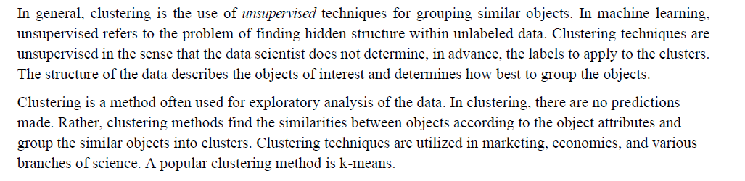

Slide 4
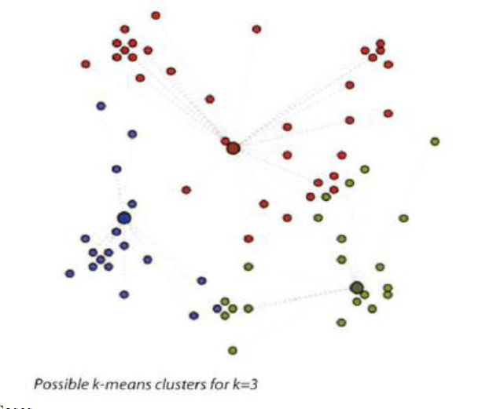
K-means
k-means is an analytical technique that, for a chosen value of k, identifies k clusters of objects based on the objects' proximity to the center of the k groups.

Slide 5
Use cases
Image Processing
Medical
Customer Segmentation

Slide 6
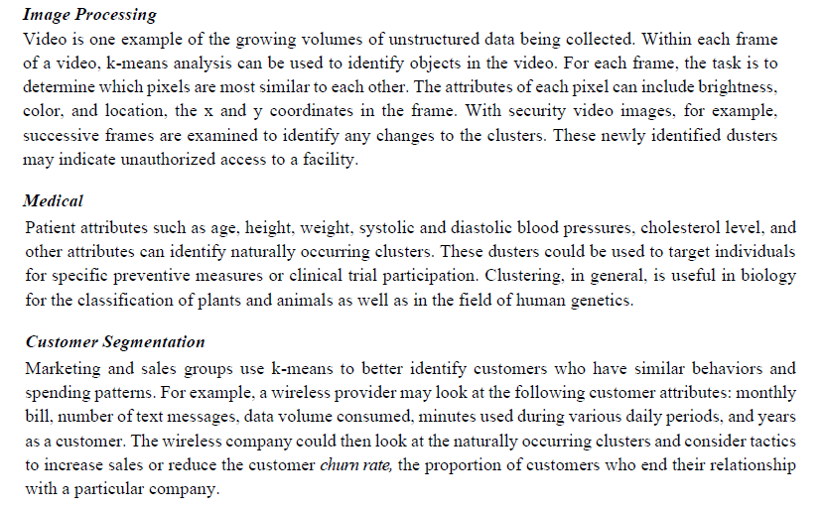

Slide 7
Overview of the Method
To illustrate the method to find k clusters from a collection of M objects with n attributes, the two-dimensional case (n = 2) is examined.
Because each object in this example has two attributes, it is useful to consider each object corresponding to the point (xi, yi), where x and y denote the two attributes and i = 1, 2 ... M.
For a given cluster of m points (m ≤ M), the point that corresponds to the cluster's mean is called a centroid.

Slide 8

The k-means algorithm to find k dusters can be described in the following four steps.
1. Choose the value of k and the k initial guesses for the centroids.
2. Compute the distance from each data point (xi ,yi ) to each centroid. Assign each point to the closest centroid. This association defines the first k dusters.
the distance, d, between any two points, (x1,y1) and (x2,y2)

Slide 9
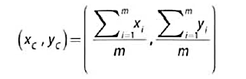
3. Compute the centroid, the center of mass, of each newly defined cluster from Step 2.
In two dimensions, the centroid (xc,yc) of the m points in a k-means duster is calculated as follows in Equation.
4. Repeat Steps 2 and 3 until the algorithm converges to an answer
a. Assign each point to the closest centroid computed in Step 3.
b. Compute the centroid of newly defined clusters.
c. Repeat until the algorithm reaches the final answer.

Slide 10
Convergence is reached when the computed centroids do not change or the centroids and the assigned points oscillate back and forth from one iteration to the next. The latter case can occur when there are one or more points that are equal distances from the computed centroid.

Slide 11
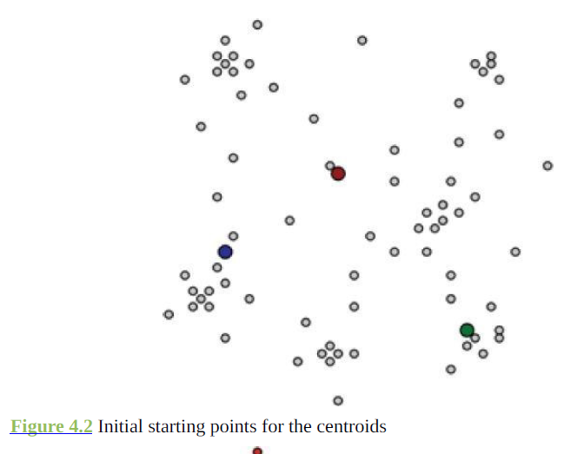

Slide 12
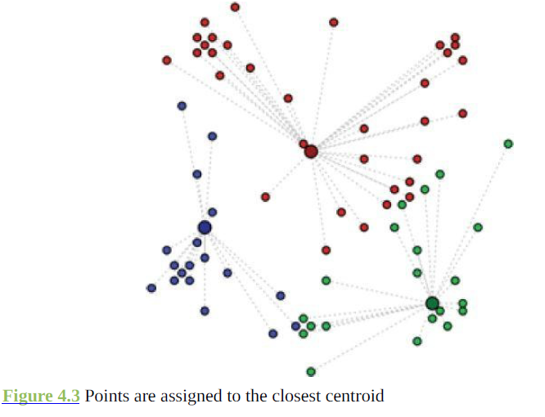

Slide 13
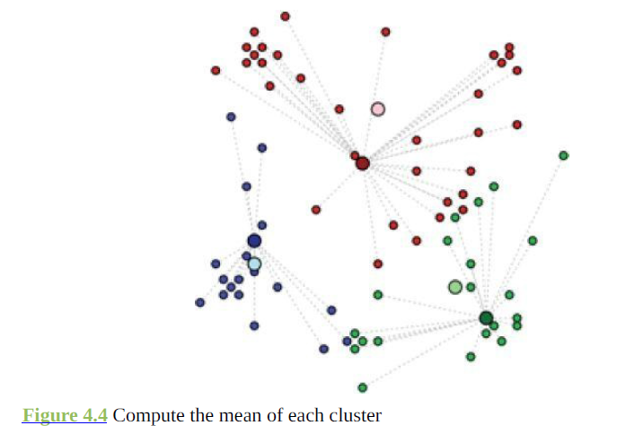

Slide 14
{2,4,10,12,3,20,11,25} consider k=2, cluster data
K=2. so 2 means
1. Let m1=2 k1={2,3}
m2=4 k2={4,10,12,20,11,25}
2. m1=2.5 k1={2,4,3}
m2=13.67 k2={10,12,20,11,25}
3. m1=3 k1={2,3,4}
m2=15.6 k2={10,12,20,11,25}
So final clusters k1={2,3,4}, k2={10,12,20,11,25}

Slide 15
Create 2 clusters
A(2,2), B(3,2), C=(1,1), D=(3,1), E=(1.5,0.50)
1. let m1=(2,2) k1={A(2,2),C(1,1),E(1.5,0.5)}
m2=(3,2) k2={(B(3,2) , D=(3,1), }
2. m1=(1.5,1.67) k1={A(2,2),C(1,1),E(1.5,0.5)}
m2= (3,1.5) k2={(B(3,2) , D=(3,1), }

Slide 16

Determining the Number of Clusters
heuristic using the Within Sum of Squares (WSS) metric is examined to determine a reasonably optimal value of k .
WSS is the sum of the squares of the distances between each data point and the closest centroid.
The term indicates the closest centroid that is associated with the ith point.
If the points are relatively close to their respective centroids, the WSS is relatively small.
Thus, if k + 1 clusters do not greatly reduce the value of WSS from the case with only k clusters, there may be little benefit to adding another cluster.

Slide 17
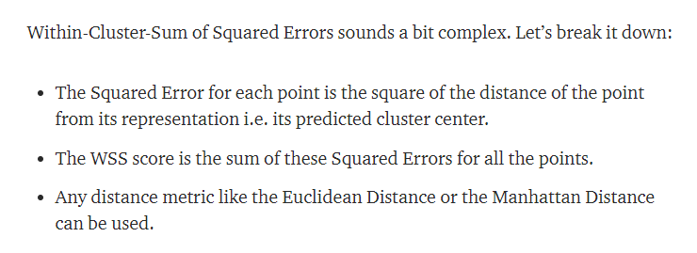

Slide 18
Diagnostics
Are the clusters well separated from each other?
Do any of the clusters have only a few points?
Do any of the centroids appear to be too close to each other?

Slide 19
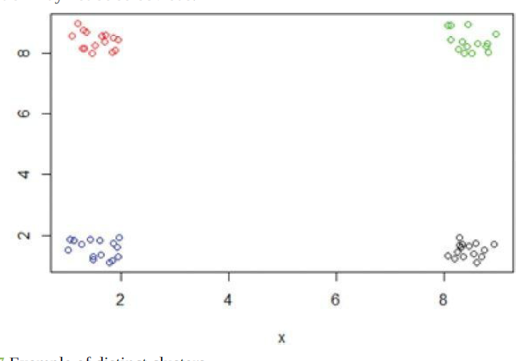

Slide 20
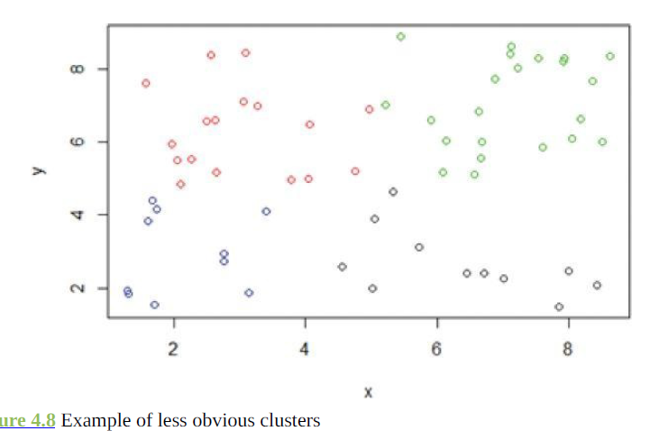

Slide 21
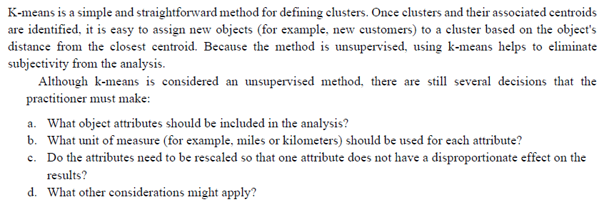
If using more clusters does not better distinguish the groups, it is almost certainly better to go with fewer clusters.

Slide 22
Reasons to Choose and Cautions
a. What object attributes should be included in the analysis?
b. What unit of measure (for example, miles or kilometers) should be used for each attribute?
c. Do the attributes need to be rescaled so that one attribute does not have a disproportionate effect on the results?
d. What other considerations might apply?

Slide 23
Objects attribute
When dealing with the problem of too many attributes, one useful approach is to identify any highly correlated attributes and use only one or two of the correlated attributes in the clustering analysis.
Another option to reduce the number of attributes is to combine several attributes into one measure. For example, instead of using two attribute variables, one for Debt and one for Assets, a Debt to Asset ratio could be used

Slide 24
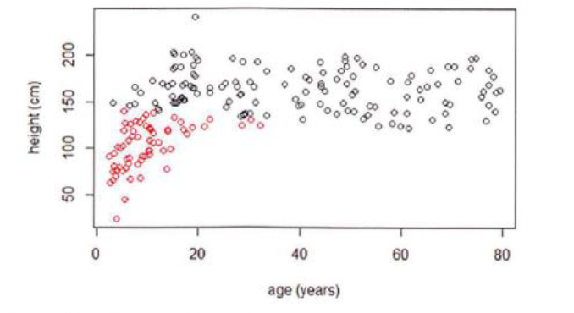
Units of Measure
example, suppose that k-means is used to cluster patients based on age in years and height in centimeters. For k=2

Slide 25
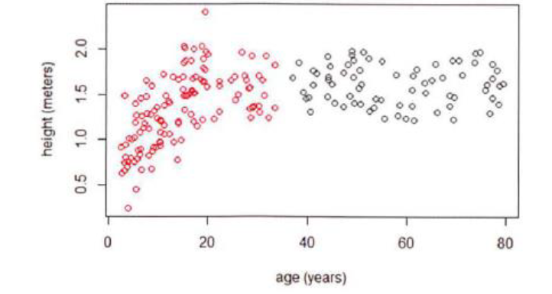

Slide 26
Association Rules

Slide 27
introduction
An unsupervised learning method called association rules.
This is a descriptive method often used to discover interesting relationships hidden in a large dataset.
The disclosed relationships can be represented as rules or frequent item sets.
Association rules are commonly used for mining transactions in databases.
association rules are sometimes referred to as market basket analysis

Slide 28
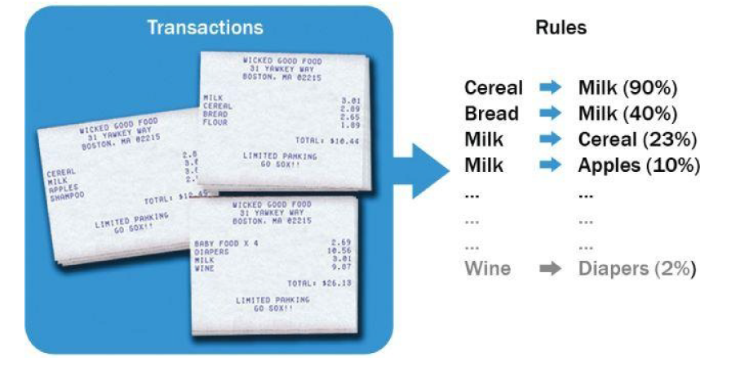

Slide 29
itemset
The term itemset refers to a collection of items
This could be a set of retail items purchased together in one transaction, a set of hyperlinks clicked on by one user in a single session, or a set of tasks done in one day.
An itemset containing k items is called a k-itemset.
curly braces like {item 1,item 2,… item k} is used to denote a k-itemset.
Computation of the association rules is typically based on itemsets.

Slide 30
Agrawal et al. [2] in the early 1990s for discovering regularities between products in a
large database of customer transactions recorded by point-of-sale systems in supermarkets.
In later years, it expanded to web contexts, such as mining path traversal patterns [3] and
usage patterns [4] to facilitate organization of web pages.

Slide 31
Applications of Association Rules
Broad-scale approaches to better merchandising—what products should be included in or excluded from the inventory each month
Cross-merchandising between products and high-margin or high-ticket items
Physical or logical placement of product within related categories of products
Promotional programs—multiple product purchase incentives managed through a loyalty card program
Recommender systems
clickstream analysis

Slide 32
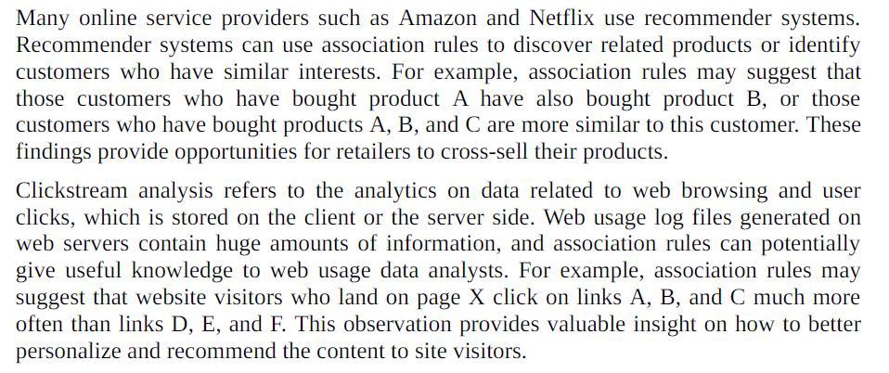

Slide 33
Apriori Algorithm
Support:
Given an itemset L, the support [2] of L is the percentage of transactions that contain L.
For example, if 80% of all transactions contain itemset {bread}, then the support of {bread} is 0.8.
Similarly, if 60% of all transactions contain itemset {bread,butter}, then the support of {bread,butter} is 0.6.

Slide 34
frequent itemset
A frequent itemset has items that appear together often enough.
is formally defined with a minimum support criterion.
the support of a frequent itemset should be greater than or equal to the minimum support.

Slide 35
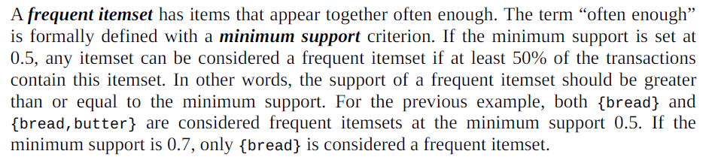
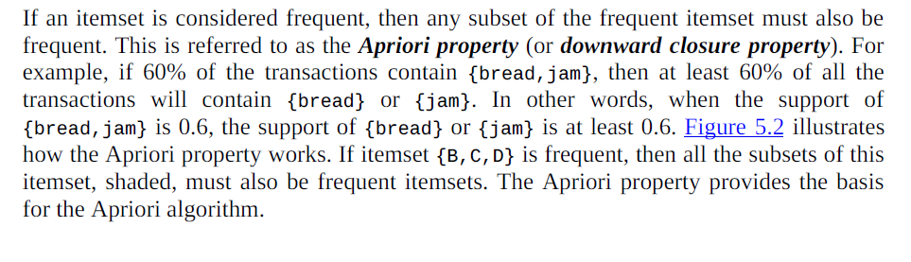

Slide 36
Apriori property (or downward closure property)
If an itemset is considered frequent, then any subset of the frequent itemset must also be frequent.
example, if 60% of the transactions contain {bread,jam}, then at least 60% of all the transactions will contain {bread} or {jam}.

Slide 37
The Apriori algorithm takes a bottom-up iterative approach to uncovering the frequent itemsets by first determining all the possible items (or 1-itemsets, for example {bread}, {eggs}, {milk}, …) and then identifying which among them are frequent.
Assuming the minimum support threshold (or the minimum support criterion) is set at 0.5, the algorithm identifies and retains those itemsets that appear in at least 50% of all transactions and discards (or “prunes away”) the itemsets that have a support less than 0.5 or appear in fewer than 50% of the transactions.
In the next iteration of the Apriori algorithm, the identified frequent 1-itemsets are paired into 2-itemsets (for example, {bread,eggs}, {bread,milk}, {eggs,milk}, …) and again evaluated to identify the frequent 2-itemsets among them.
At each iteration, the algorithm checks whether the support criterion can be met; if it can, the algorithm grows the itemset, repeating the process until it runs out of support or until the itemsets reach a predefined length.

Slide 38
Apply apriori algorithm. Min support=50%,
Min confidence=75%
Trnsaction ID | Items
100 | 1,3,4
200 | 2,3,5
300 | 1,2,3,5
400 | 2,5

Slide 39
D=4
Candidate Item set =K1={1,2,3,4,5}

Slide 40
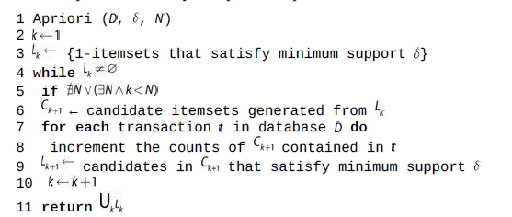

Slide 41
Let
variable be the set of candidate k-itemsets and variable be the set of k-itemsets that
satisfy the minimum support. Given a transaction database , a minimum support
threshold , and an optional parameter indicating the maximum length an itemset could
reach, Apriori iteratively computes frequent itemsets based on .

Slide 42

Evaluation of Candidate Rules
Confidence
measure of certainty or trustworthiness associated with each discovered rule.
confidence is the percent of transactions that contain both X and Y out of all the transactions that contain X

Slide 43
A relationship may be thought of as interesting when the algorithm identifies the relationship with a measure of confidence greater than or equal to a predefined threshold.
This predefined threshold is called the minimum confidence.
A higher confidence indicates that the rule (X → Y) is more interesting or more trustworthy, based on the sample dataset.

Slide 44
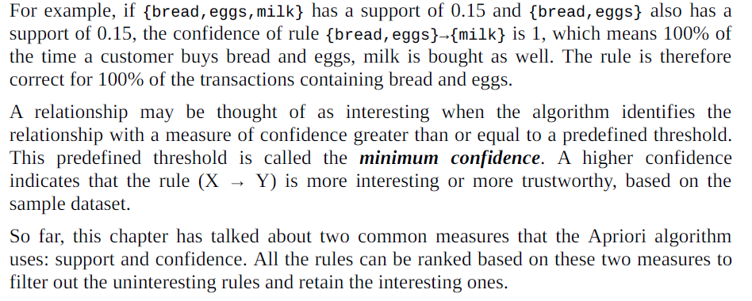
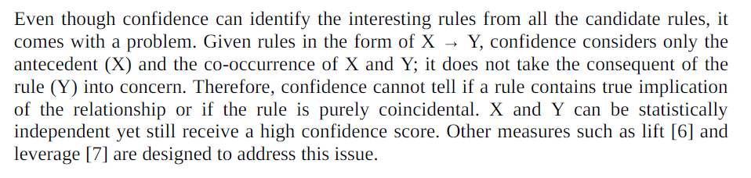

Slide 45
Measure 3: Lift. This says how likely item Y is purchased when item X is purchased, while controlling for how popular item Y is. In Table 1, the lift of {apple -> beer} is 1,which implies no association between items. A lift value greater than 1 means that item Y is likely to be bought if item X is bought, while a value less than 1 means that item Y is unlikely to be bought if item X is bought.

Slide 46

Lift measures how many times more often X and Y occur together than expected if they are statistically independent of each other.
Lift is 1 if X and Y are statistically independent of each other.
In contrast, a lift of X → Y greater than 1 indicates that there is some usefulness to the rule.
A larger value of lift suggests a greater strength of the association between X and Y.

Slide 47
Assuming 1,000 transactions, with (milk, eggs} appearing in 300 of them, {milk} appearing in 500, and {eggs} appearing in 400, then Lift(milk—>eggs) = 0.3/(0.5*0.4) = 1.5.
If {bread} appears in 400 transactions and {milk, bread} appears in 400, then Lift(milk —>bread) = 0.4/(0.5*0.4) = 2.
Therefore it can be concluded that milk and bread have a stronger association than milk and eggs.

Slide 48
Leverage
Leverage measures the difference in the probability of X and Y appearing together in the dataset compared to what would be expected if X and Y were statistically independent of each other.
Leverage(X —> Y) = Support(X ˄Y ) - Support(X)* Support(Y)

Slide 49
In theory, leverage is 0 when X and Y are statistically independent of each other.
If X and Y have some kind of relationship, the leverage would be greater than zero.
A larger leverage value indicates a stronger relationship between X and Y.
For the previous example, Leverage{milk —> eggs) = 0.3-(0.5*0.4) = 0.1 and Leverage(milk -> bread)=0.4 - (0.5 * 0.4) = 0.2.
It again confirms that milk and bread have a stronger association than milk and eggs.

Slide 50
Diagnostics
Lifecycle (Chapter 2), the team must specify the minimum support prior to the model execution, which may lead to too many or too few rules. In related research, a variant of the algorithm [13] can use a predefined target range for the number of rules so that the algorithm can adjust the minimum support accordingly.
The Apriori algorithm reduces the computational workload by only examining itemsets that meet the specified minimum threshold. However, depending on the size of the dataset, the Apriori algorithm can be
computationally expensive. For each level of support, the algorithm requires a scan of the entire database to obtain the result. Accordingly, as the database grows, it takes more time to compute in each run.

Slide 51
Diagnostics
some approaches to improve Apriori’s efficiency:
Partitioning: Any itemset that is potentially frequent in a transaction database must
be frequent in at least one of the partitions of the transaction database.
Sampling: This extracts a subset of the data with a lower support threshold and uses
the subset to perform association rule mining.
Transaction reduction: A transaction that does not contain frequent k-itemsets is
useless in subsequent scans and therefore can be ignored.
Hash-based itemset counting: If the corresponding hashing bucket count of a kitemset
is below a certain threshold, the k-itemset cannot be frequent.
Dynamic itemset counting: Only add new candidate itemsets when all of their
subsets are estimated to be frequent.

Slide 52
Regression

Slide 53
regression analysis attempts to explain the influence that a set of variables has on the outcome of another variable of interest.
the outcome variable is called a dependent variable because the outcome depends on the other variables.
Additional variables are sometimes called the input variables or the independent variables.

Slide 54
Regression analysis is useful for answering the following kinds of questions:
What is a person’s expected income?
What is the probability that an applicant will default on a loan?

Slide 55
Linear Regression
It is used for predicting the continuous dependent variable with the help of independent variables.
The goal of the Linear regression is to find the best fit line that can accurately predict the output for the continuous dependent variable.
If single independent variable is used for prediction then it is called Simple Linear Regression and if there are more than two independent variables then such regression is called as Multiple Linear Regression.
By finding the best fit line, algorithm establish the relationship between dependent variable and independent variable.

Slide 56
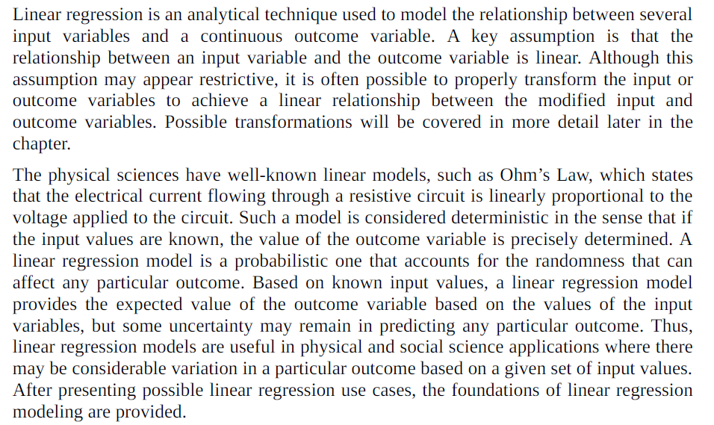

Slide 57
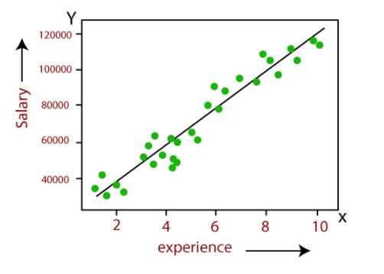

Slide 58
Use Cases
Real estate: A simple linear regression analysis can be used to model residential home prices as a function of the home’s living area.
Demand forecasting: Businesses and governments can use linear regression models to predict demand for goods and services.
Medical: A linear regression model can be used to analyze the effect of a proposed radiation treatment on reducing tumor sizes.

Slide 59
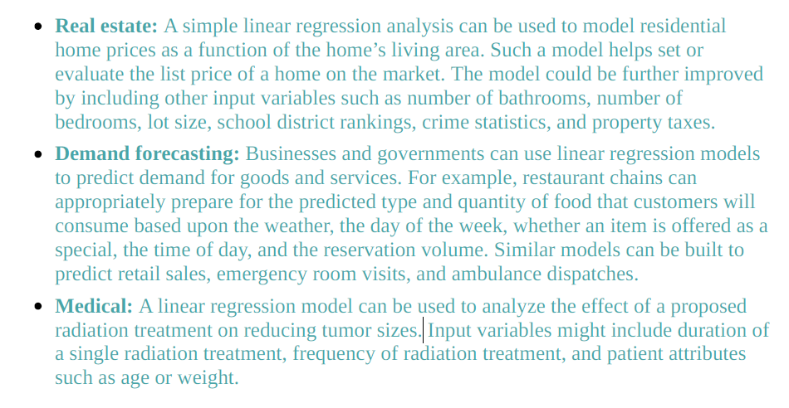

Slide 60

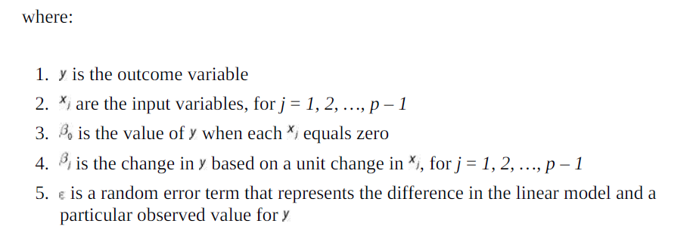
linear relationship between the input variables and the outcome variable

Slide 61


Slide 62
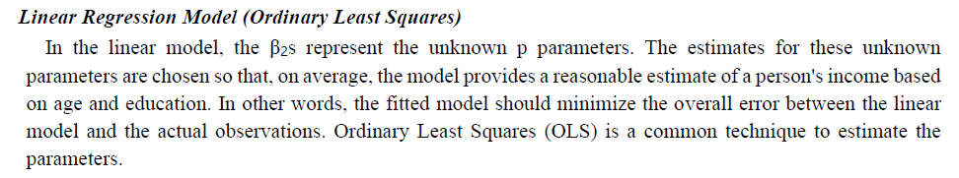

Slide 63
Linear Regression Model (Ordinary Least Squares)
the fitted model should minimize the overall error between the linear model and the actual observations.
Ordinary Least Squares (OLS) is a common technique to estimate the parameters.

Slide 64
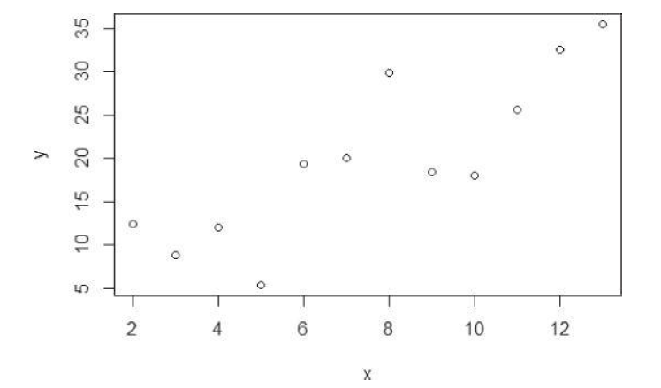
How OLS works?

Slide 65

The goal is to find the line that best approximates the relationship between the outcome variable and the input variables.
With OLS, the objective is to find the line through these points that minimizes the sum of the squares of the difference between each point and the line in the vertical direction.
i.e to find the values of β0 and β1, such that the summation shown in Equation is minimized.

Slide 66
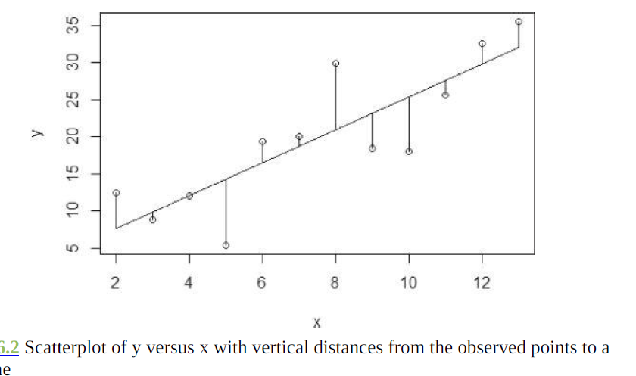
The n individual distances to be squared and then summed are illustrated in below figure. The vertical lines represent the distance between each observed y value and the line y = β0 + β1x1

Slide 67
Linear Regression Model (with Normally Distributed Errors)
in most linear regression analyses it is assume that the error term is a normally distributed random variable with mean equal to zero and constant variance.
Thus, the linear regression model is expressed as shown

Slide 68

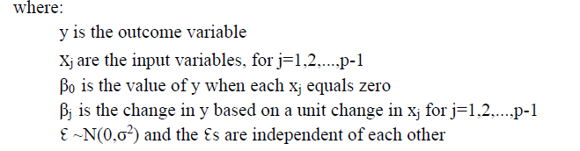

Slide 69
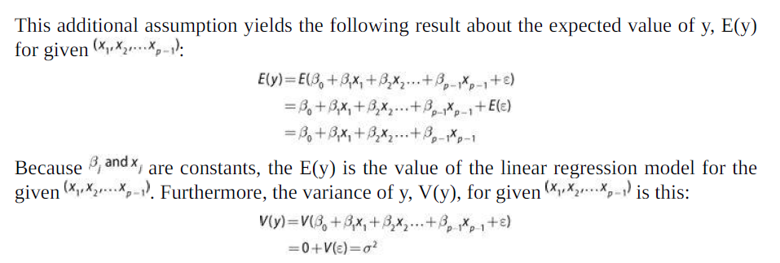

Slide 70
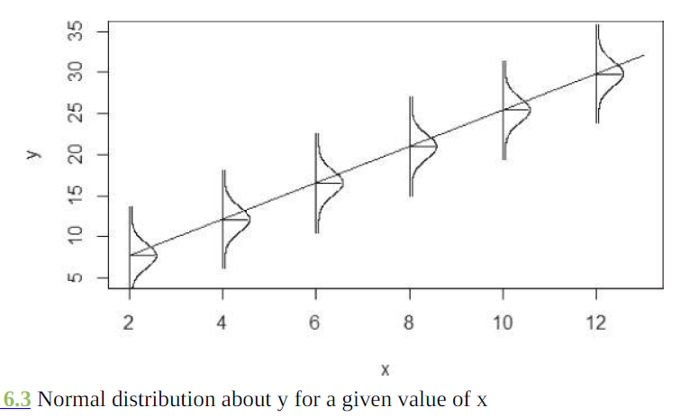
For a regression model with just one input variable the normality assumption on the error terms and the effect on the outcome variable,for a given value of .

Slide 71
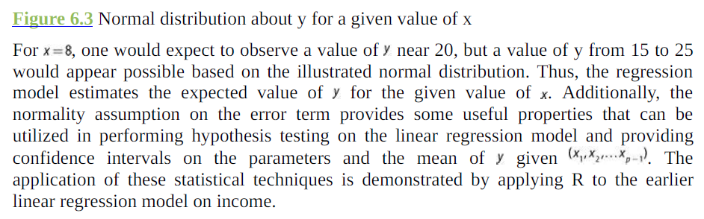

Slide 72
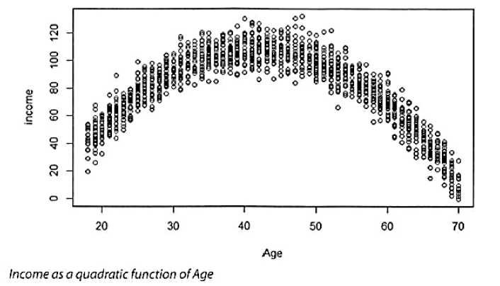
Diagnostics
Evaluating the Linearity Assumption
plot the outcome variable against each input variable.

Slide 73
In such a case, it is often useful to do any of the following:
Transform the outcome variable.
Transform the input variables.
Add extra input variables or terms to the regression model.
Common transformations include taking square roots or the logarithm of the variables.

Slide 74
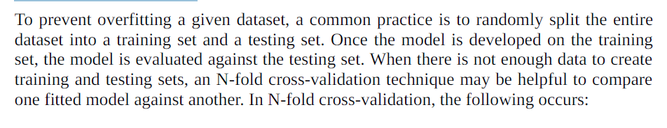

Slide 75
N-Fold Cross-Validation
In N-fold cross-validation, the following occurs:
The entire dataset is randomly split into N datasets of approximately equal size.
A model is trained against N – 1 of these datasets and tested against the remaining dataset. A measure of the model error is obtained.
This process is repeated a total of N times across the various combinations of N datasets taken N – 1 at a time.
The observed N model errors are averaged over the N folds.
The averaged error from one model is compared against the averaged error from another model.

Slide 76
Logistic regression
In linear regression modeling, the outcome variable is a continuous variable.
when the outcome variable is categorical in nature, logistic regression can be used to predict the likelihood of an outcome based on the input variables.

Slide 77
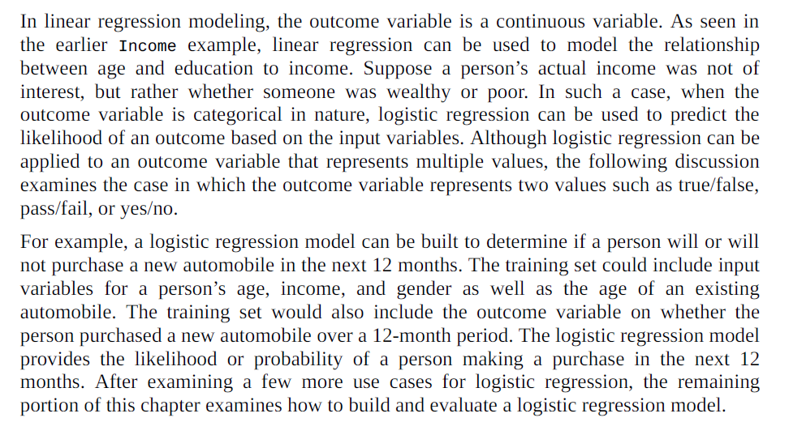

Slide 78
Use Cases
Medical: Develop a model to determine the likelihood of a patient's successful response to a specific medical treatment or procedure. Input variables could include age, weight, blood pressure, and cholesterol levels.
Finance: Using a loan applicant's credit history and the details on the loan, determine the probability that an applicant will default on the loan. Based on the prediction, the loan can be approved or denied, or the terms can be modified.

Slide 79
Marketing: Determine a wireless customer's probability of switching carriers (known as churning) based on age, number of family members on the plan, months remaining on the existing contract, and social network contacts. With such insight, target the high-probability customers with appropriate offers to prevent churn.
Engineering: Based on operating conditions and various diagnostic measurements, determine the probability of a mechanical part experiencing a malfunction or failure. With this, probability estimate, schedule the appropriate preventive maintenance activity.

Slide 80


Model Description
Logistic regression is based on the logistic function f(y)
the value of the logistic function f(y) varies from 0 to 1 as y increases.

Slide 81
Linear regression is suitable when the input variables are continuous or discrete, including categorical data types, but the outcome variable is continuous.
If the outcome variable is categorical, logistic regression is a better choice.

